Slide 1
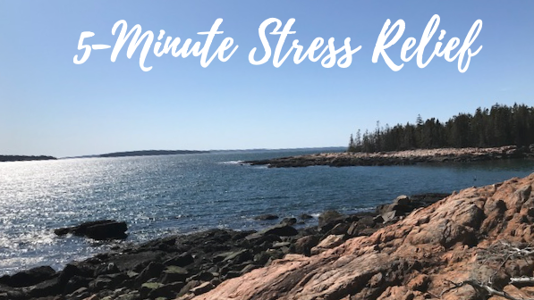
Part 2: Breathwork

Slide 2
Breathwork
Deep breathing benefits
Deep breathing - one of the best ways to lower stress in the body.
By activating the parasympathetic nervous system, it sends a message to your brain to calm down
Reduced anxiety
Reduced pain by releasing endorphins
Can lower or stabilize blood pressure and heart rate
More oxygen to the whole body – feel more energized
Improved lymphatic flow – immune system benefits
Improved sleep

Slide 3
Today’s exercises with focus on breath
Always start exercises with checking in and "sigh of relief“ to focus/reset
How do we take a deep breath and relax? (hint: “take a deep breath” is wrong)
“Abdominal” (diaphragmatic/deep) breathing
Three-part breath
SLEDS (slow, long, even, deep, soft breath)
Observing breaths as meditation
Breath holding techniques may be stressful for many people
Movement to open lungs and relax
flying phoenix with variations

Slide 4
Five Minute Lung Routine (or longer…)
Check in, sigh of relief (noticing current state, reset with sigh)
Bouncing with arms down then up (to “wake up the body” and open shoulders)
Tapping /cupping chest (to promote blood/lymph flow and clear any phlegm)
Flying phoenix (moving meditation, deepening breaths)
Meditation: I love my lungs! (positive message with focus on lungs)
Tapping arms – at least (to exit from meditation - alpha brain waves back to beta brain waves – back to “regular day”)
Checking in! (noticing current body feelings and focus on positive sensations)

Slide 5
Thank you!

