Slide 1
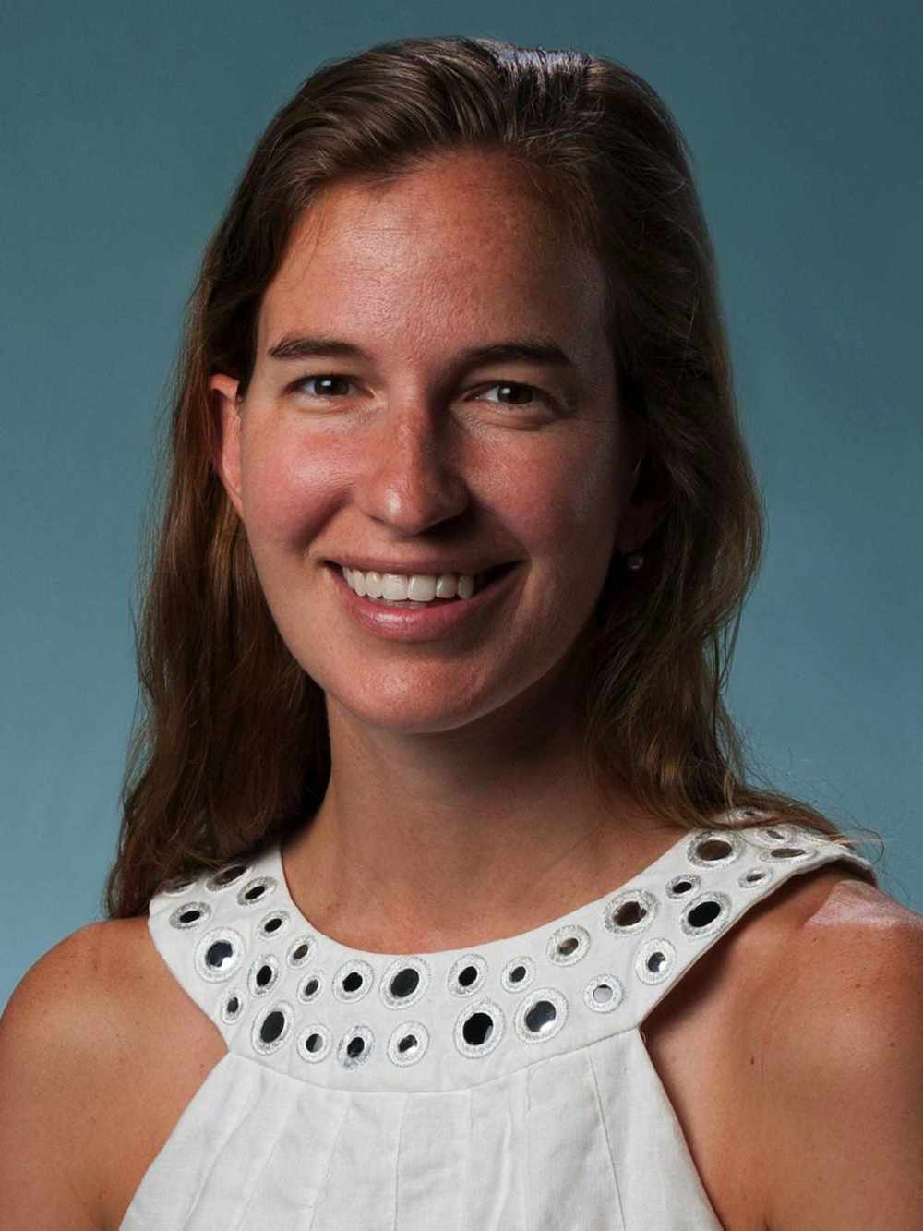
Pediatric Grand Rounds 03/09/2023
Dr. Anne Coates (Maine Medical Center) presents:
“A Collaboration of Pediatric Pulmonary Cases”
The speaker/planners have no relevant financial relationship(s) with commercial interest to disclose nor do they have an interest in selling a technology, program, product and/or service to CME Professionals.

Slide 2
Accreditation Statement
Northern Light Eastern Maine Medical Center designates this educational activity for a maximum of ( 1.0 ) AMA PRA Category 1 Credits TM. Physicians should only claim credit commensurate with the extent of their participation in the activity.
Northern Light Eastern Maine Medical Center is accredited by the Maine Medical Association Committee on Continuing Medical Education and Accreditation to provide continuing medical education to physicians.

Slide 3
Objectives
At the end of this presentation, learners should be able to:
Review 3 shared pediatric pulmonary cases.
Identify teaching points within each pediatric pulmonary case.
Review future opportunities for collaboration.

