Slide 1
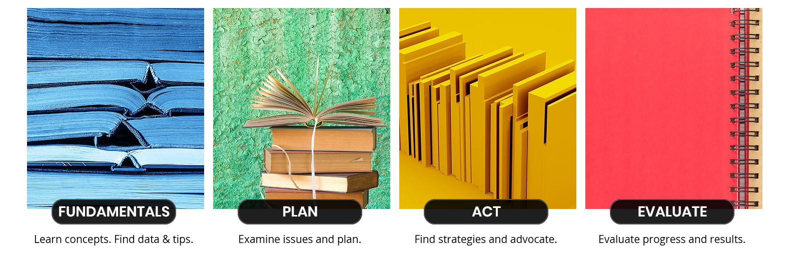
Familiarize Workforce with Resources
Educate and empower managers to lead on both mental health and inclusion.
Get grounded in organizational values and workplace culture.
Be intentional about doing the work.
Pace yourself: again, slow your roll and act with urgency.
www.racialequitytools.org/
Good Health Is Good Business

