Slide 1
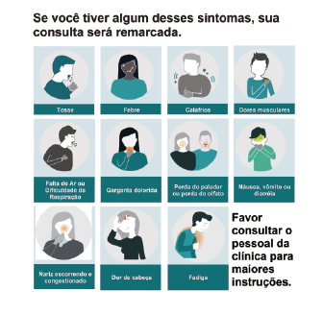
Multilingual signage and handouts

